Slide 1
Collaboration Diagram

Slide 2
Introduction
The second interaction diagram is collaboration diagram.
It shows the object organization.
Here in collaboration diagram the method call sequence is indicated by some numbering technique.
The number indicates how the methods are called one after another.
Purpose
A collaboration diagram shows the objects and relationships involved in an interaction, and the sequence of messages exchanged among the objects during the interaction.

Slide 3
Contd..
The method calls are similar to that of a sequence diagram.
But the difference is that the sequence diagram does not describe the object organization where as the collaboration diagram shows the object organization.
Compared with a sequence diagram
A sequence diagram shows the objects and messages involved in an interaction.
It shows the timing of the messages, but not the relationships among the objects.

Slide 4
Contd…
Now to choose between these two diagrams the main emphasis is given on the type of requirement.
If the time sequence is important then sequence diagram is used and if organization is required then collaboration diagram is used.
Collaboration diagrams show interaction without the time dimension, but do include object links.

Slide 5
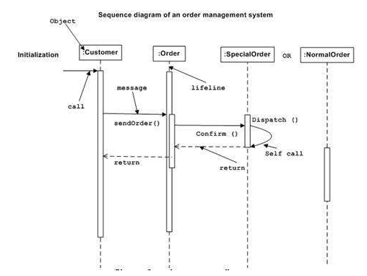

Slide 6
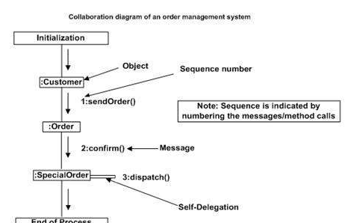

Slide 7
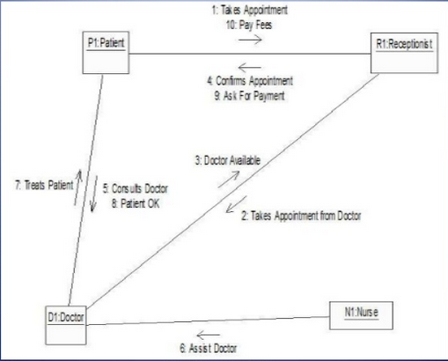

Slide 8
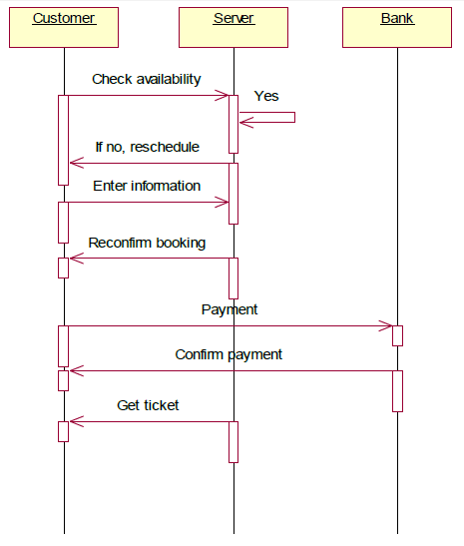

Slide 9
